Slide 1

Time Series Data Analysis and Forecasting Final Project
2024 Spring Semester
Professor Myungsuk, Kim
Team 1
Trend, Seasonality Analysis, and Enhancement Strategies for Japanese Tourists in Korea
: A Regression and Time Series Data Analysis

Slide 2
Time Series Data Analysis and Forecasting Final Project
Contents
Contents
Introduction
Problem Motivation
Literature Review
Statement of Research Objectives
Methodology and Result
Expected Original Contribution
Reference List

Slide 3
Time Series Data Analysis and Forecasting Final Project
Introduction
Introduction
Trend, Seasonality Analysis, and Enhancement Strategies for Japanese Tourists in Korea
: A Regression and Time Series Data Analysis
Analyze the relationship between the number of times Japanese Users Searched for Keywords About Korea and the Number of Japanese Visitors to Korea with regression
Supplementary forecasting analysis
Find enhancement strategies for Japanese tourists in Korea using above analysis results

Slide 4
Time Series Data Analysis and Forecasting Final Project
Problem Motivation
Problem Motivation
Increasing Rate of Domestic travel in Korea slows down after the COVID-19
*units 1000 times, %
Chart : Number of domestic travel and increasing rate
source: Ministry of Culture, Sports and Tourism, South Korea
Year | Annual | 1Q | 2Q | 3Q | 4Q
2019 | 344,750 | 84,061 | 80,915 | 90,658 | 89,116
2020 | 225,199 | 59,100 | 55,818 | 59,319 | 50,962
2021 | 245,127 | 54,277 | 65,810 | 64,588 | 60,452
2022 | 283,722 | 65,228 | 71,903 | 75,759 | 70,833
2023(B) | 296,977 | 73,374 | 73,366 | 75,893 | 71,344
Growth rate (B-A) | 4.7 | 17.1 | 2.0 | 0.2 | 0.7

Slide 5
Time Series Data Analysis and Forecasting Final Project
Problem Motivation
Problem Motivation
Develop enhancement strategies of foreign tourists in Korea considering the increasement potential
- To make practical solution, we need to target the country that has meaningful impact to the total number of foreign travelers
- For travel purpose, more than 20% of the foreign tourists visited Korea are Japanese.
Chart : Annual number of travelers from Japan and total
source: Ministry of Culture, Sports and Tourism, South Korea
Unit: 명(person)
 | 2015Y | 2016Y | 2017Y | 2018Y | 2019Y | 2020Y | 2021Y | 2022Y | 2023Y | 2024Y | Total
JAPAN | 1,742,531 | 2,213,099 | 2,223,214 | 2,864,110 | 3,179,436 | 406,701 | 1,047 | 259,031 | 2,258,375 | 874,659 | 16,022,203
TOTAL | 10,135,489 | 13,932,925 | 10,415,594 | 12,414,348 | 14,432,275 | 1,653,471 | 211,846 | 1,998,937 | 8,880,899 | 3,928,048 | 78,003,832
Percentage | 17.19% | 15.88% | 21.35% | 23.07% | 22.03% | 24.60% | 0.49% | 12.96% | 25.43% | 22.27% | 20.54%

Slide 6
Time Series Data Analysis and Forecasting Final Project
Problem Motivation
Problem Motivation
3) Find enhancement strategies for Japanese tourists in Korea to boost the domestic travel economy
According to JNTO(Japan National Tourism Organization), the number of tourists in Japan who are Korean is as below chart
Total population Japan in 24Y is 122,631,432 and that of Korea in 24Y is 51,751,065.
Even considering the exchange rate problem, the number of Korean tourists visiting Japan is heavily outweighs than that of Japanese tourists visiting Korea, even though the Japan population is more than twice as large.
* Each data from JNTO and Ministry of Culture, Sports and Tourism, South Korea
 | Oct 23 | Nov 23 | Dec 23 | Jan 24 | Feb 24
Korea to Japan | 631,120 | 649,880 | 782,730 | 857,000 | 818,500
Japan to Korea | 250,235 | 272,686 | 191,892 | 137,713 | 177,633

Slide 7
Time Series Data Analysis and Forecasting Final Project
Literature Review
Literature Review
Molemeng. (2023). The Factors Influencing the Number of Visits and Behavioral Intentions of China, Japan and U.S. Tourists - Based on KTO 2019 International Visitor Survey. Master's thesis, Sejong University, Graduate School, Department of Hotel and Tourism Management.
Deukhee Park, Sanghoon Kang, and Gyehee Lee. "Demand Forecasting of Japanese Tourists to Korea for Sustainable Tourism Growth: An Application of Time-Series Econometric Models." Journal of Tourism Studies 34, no. 3 (2020): 47-60. doi: https://doi.org/10.21298/IJTHR.2020.3.34.3.47.
Soeon Park, Gunhee Lee, Inhye Lee. “Analysis of Factors of Visiting Tourists to Korea using Economic Variables and Media Data: A Case Study of Japan and Chinese Tourist.” International Journal of Tourism and Hospitality Research 29, no. 7 (2015)

Slide 8
Time Series Data Analysis and Forecasting Final Project
Literature Review
Literature Review
Prior studies mainly focused on either forecasting or factor analysis (which factor affects the number of tourists) of the data regarding the tourism in Korea.
While there are studies that forecast the number of visitors by adjusting for the impact of COVID-19 or analyze factors influencing visitation, there is a lack of research that comprehensively considers seasonality, trends, and influencing factors targeting a specific country to boost the number of tourists.

Slide 9
Time Series Data Analysis and Forecasting Final Project
Statement of Research Objectives
Statement of Research Objectives
1. Analyze What factors makes Japanese visit Korea using regression model between keyword data and tourist data
2. Interpret Trend and Seasonality of Japanese tourist data using decomposed model
3. Predict the number of Japanese tourists in Korea using SARIMA model
4. Properly interpret the meaning of analysis results and find strategies accordingly

Slide 10
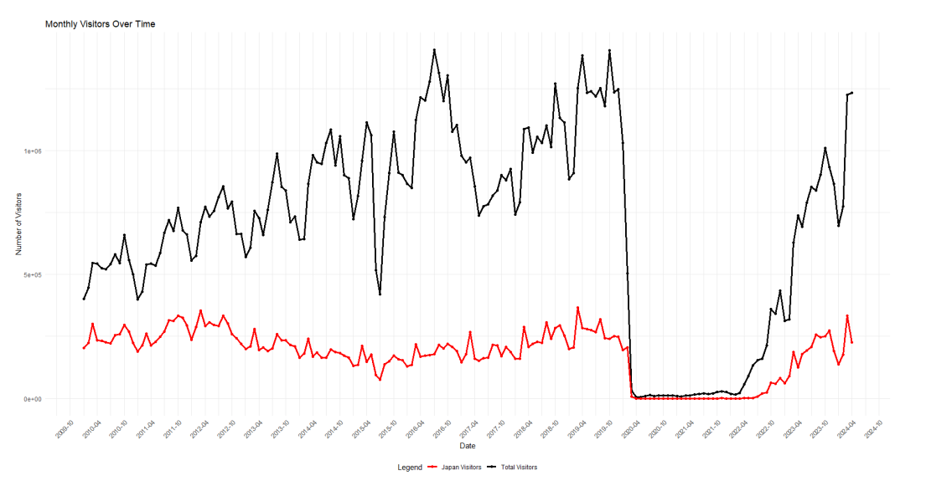
Time Series Data Analysis and Forecasting Final Project
Methodology and Result
3
Dependent variable: Monthly visitors

Slide 11
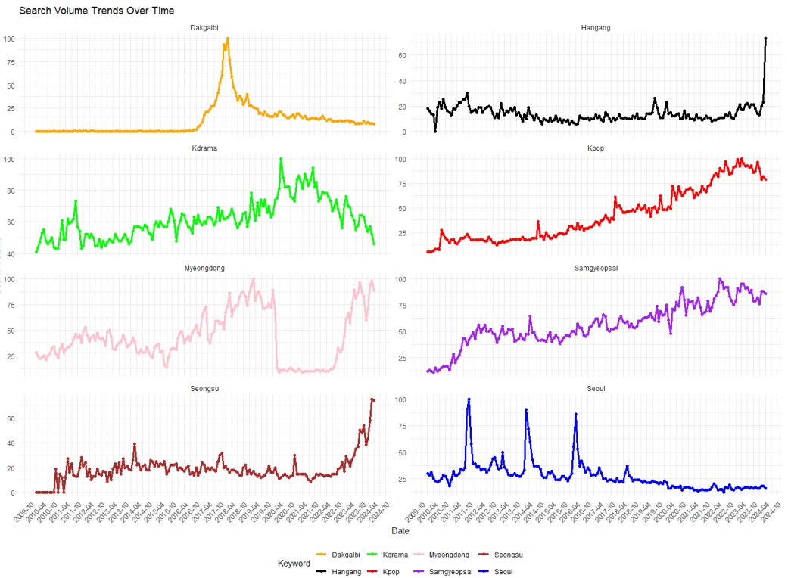
Time Series Data Analysis and Forecasting Final Project
Methodology and Result
3
Exogenous variables

Slide 12
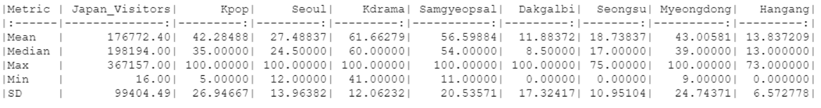
Time Series Data Analysis and Forecasting Final Project
Methodology and Result
3
Descriptive Statistics for Variables

Slide 13
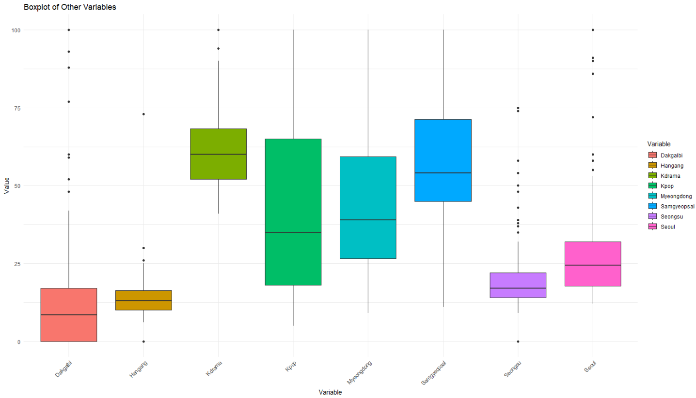
Time Series Data Analysis and Forecasting Final Project
Methodology and Result
3
Boxplot for Variables

Slide 14
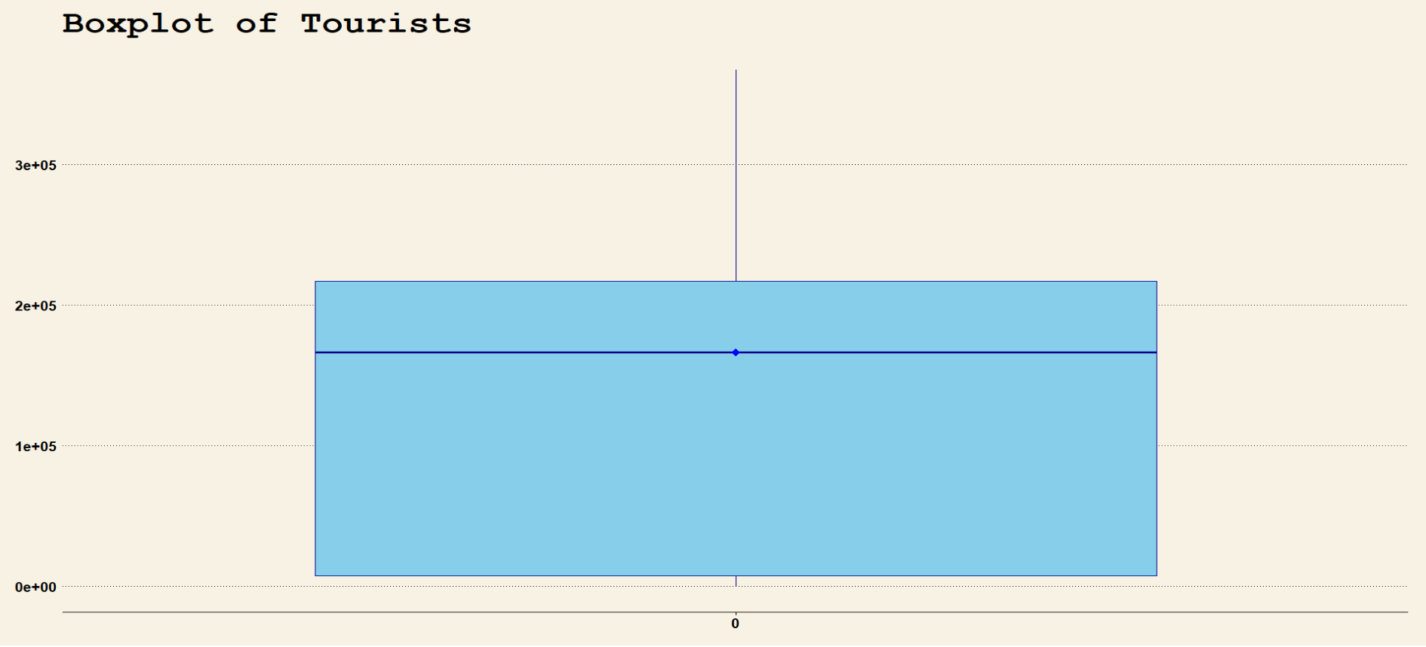
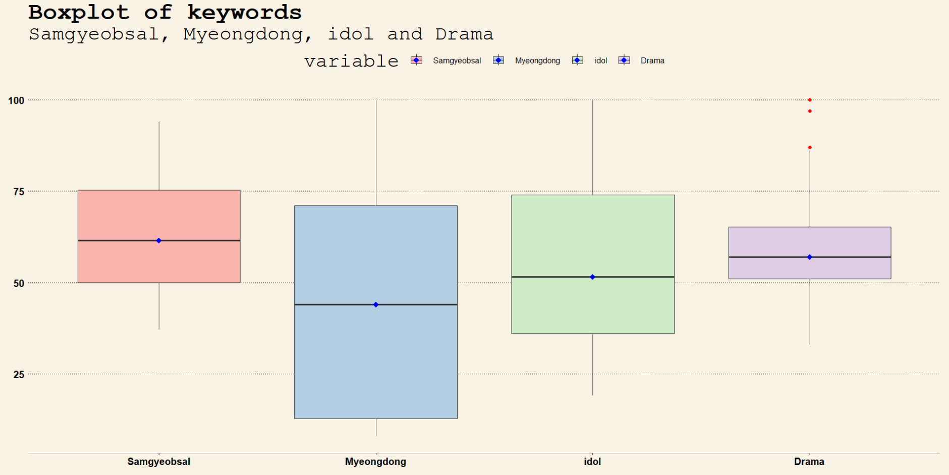
Time Series Data Analysis and Forecasting Final Project
Methodology and Result
3
Boxplot

Slide 15
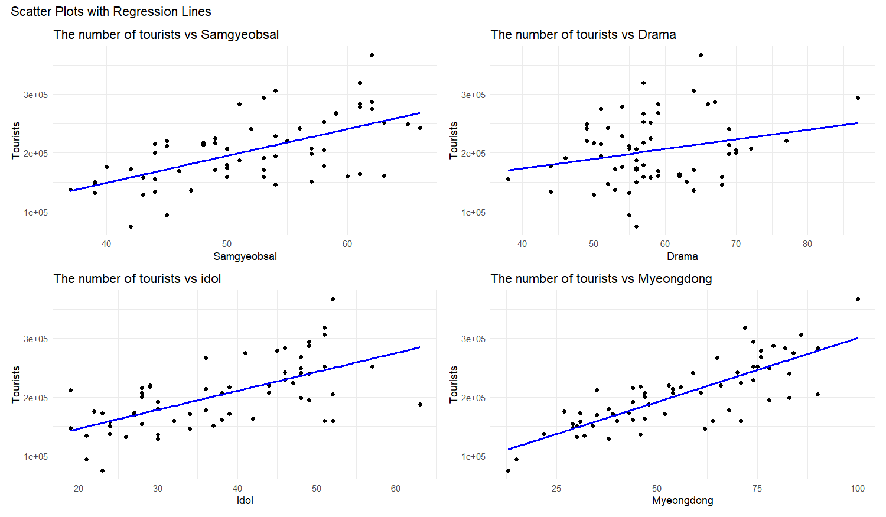
Time Series Data Analysis and Forecasting Final Project
Methodology and Result
Loading the Dataset
Scatter Plots with each keyword
Results
Positive slopes for every model

Slide 16
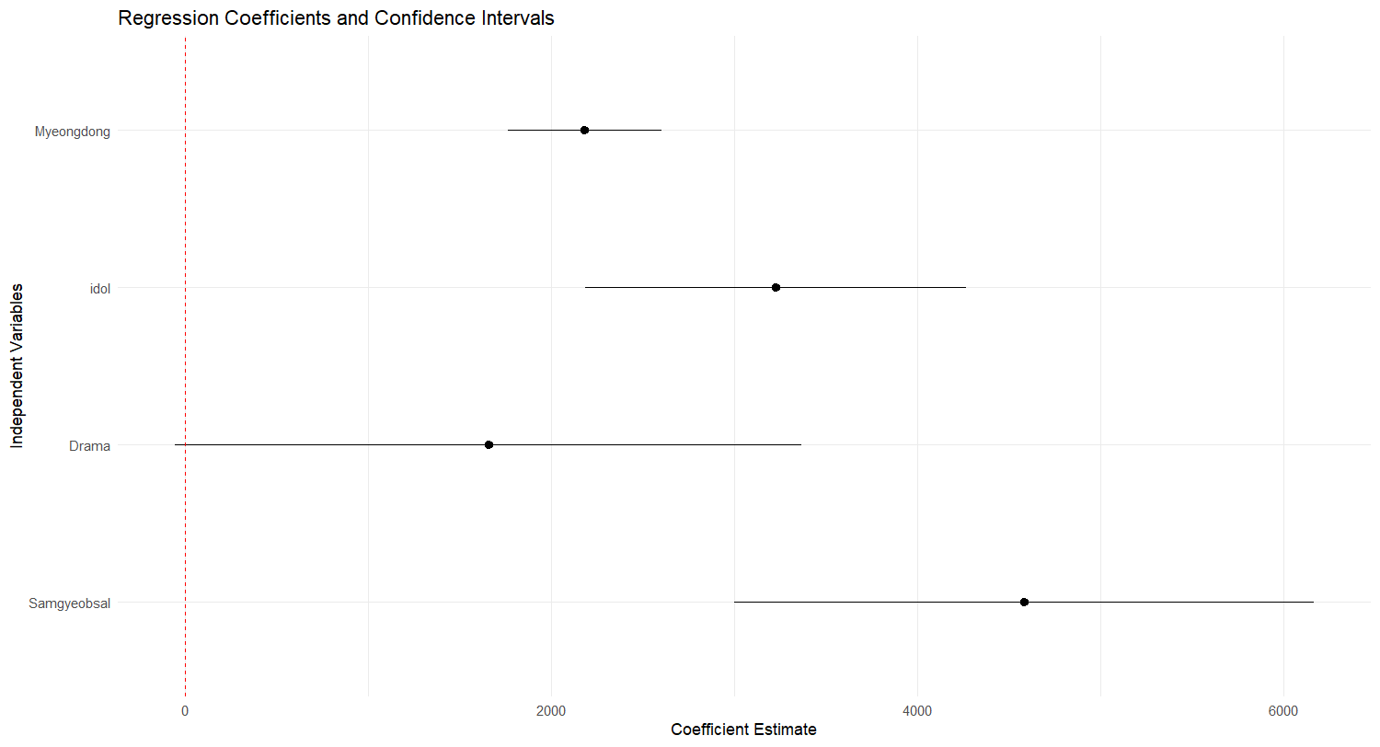
Time Series Data Analysis and Forecasting Final Project
Methodology and Result
Coefficient Plot for each simple regression model
Visualisation
: Without Drama,
Myeongdong, idol, and Samgyeobsal are significant
at a significant level of 5%
2. Interpretation
: Japanese tourists came to Korea for food, place, and idol.

Slide 17
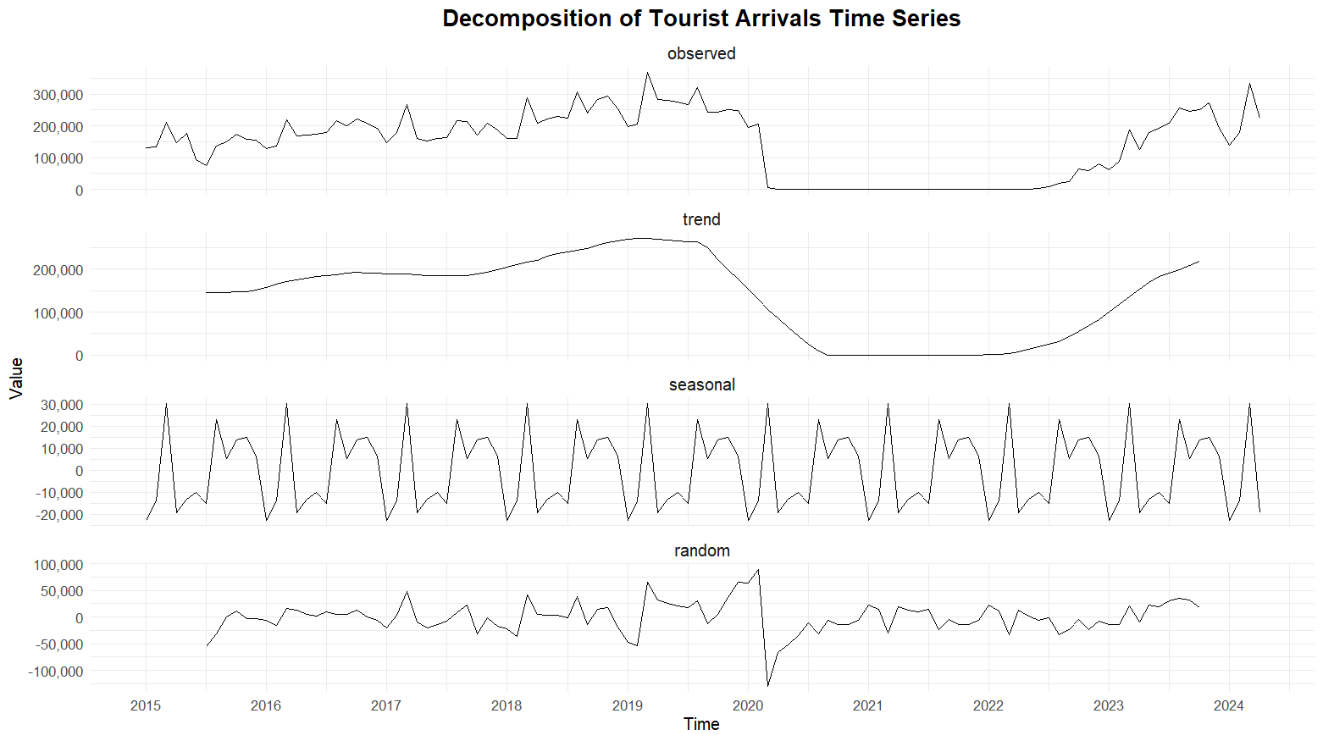
Time Series Data Analysis and Forecasting Final Project
Methodology and Result
Decomposition Model
Result: Clear Seasonality Weird Trend due to COVID-19

Slide 18
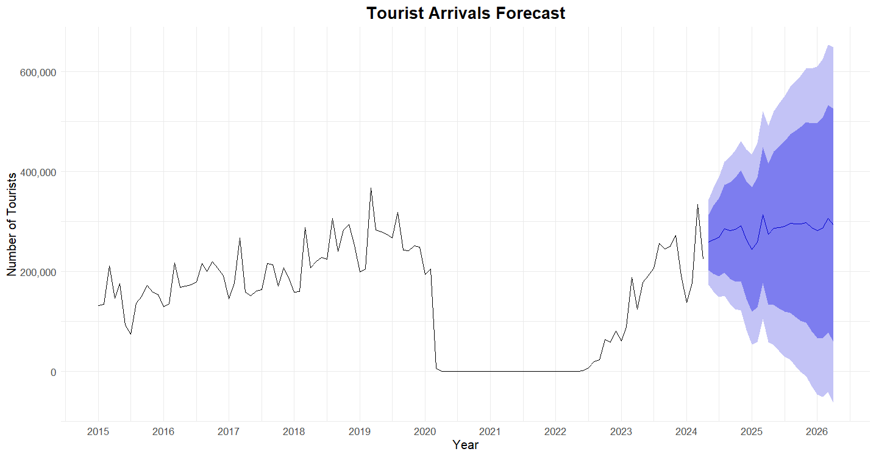
Time Series Data Analysis and Forecasting Final Project
Methodology and Result
Prediction using SARIMA
Result: ARIMA(0,1,1)(1,0,0)[12]
Point Forecast
Time | Tourists
May 2024 | 258816
Aug 2024 | 285926
Nov 2024 | 291745
Feb 2025 | 258432
May 2025 | 286884
Aug 2025 | 296384
Nov 2025 | 298424

Slide 19
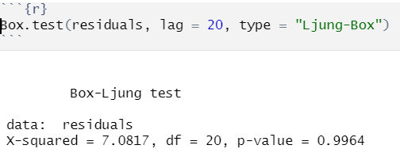
Time Series Data Analysis and Forecasting Final Project
Methodology and Result
Box-Ljung test

Slide 20
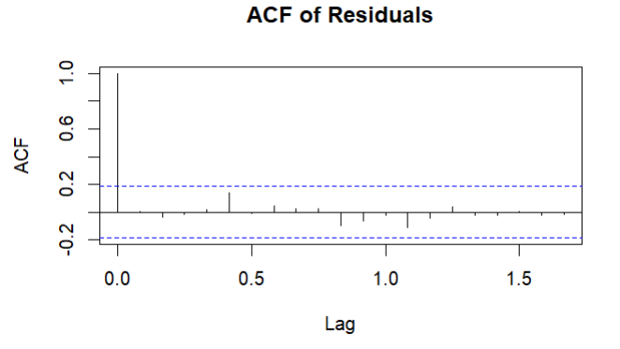
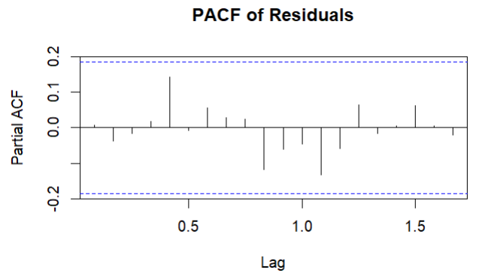
Time Series Data Analysis and Forecasting Final Project
Methodology and Result
3
ACF, PACF of Residuals

Slide 21
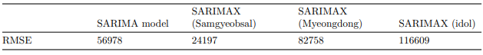
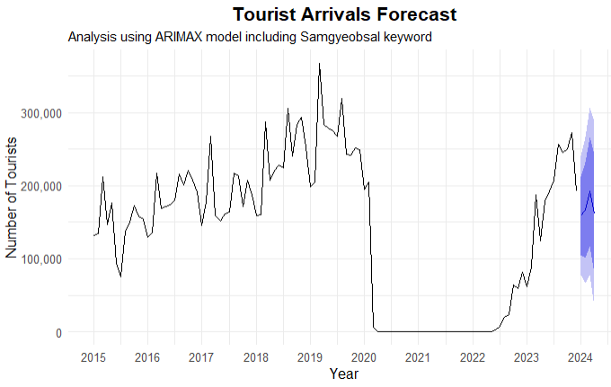
Time Series Data Analysis and Forecasting Final Project
Methodology and Result
Analysis using ARIMAX model including Samgyeosal keyword
SARIMAX model including Samgyeosal keyword
Using the SARIMAX model improves the accuracy of the tourist arrival forecasts compared to the basic ARIMA model, as evidenced by the lower RMSE values

Slide 22
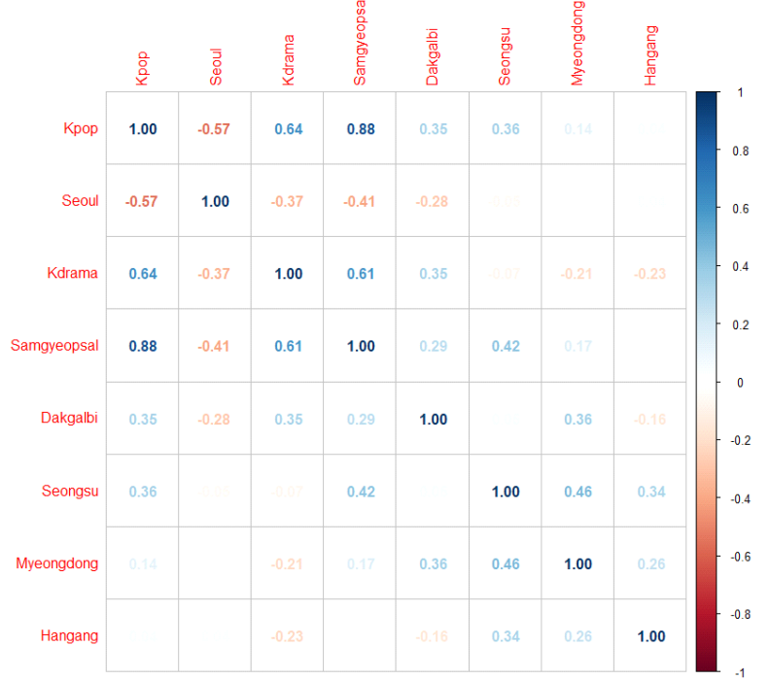
Time Series Data Analysis and Forecasting Final Project
Methodology and Result
SARIMAX model including multiple keywords
Classification of keywords
: Keywords can be classified into place, food, and so on
: Rather than using one exogenous variable, the model could include more than two exogenous variables
2. Hit-map representation
: Hit-map shows that Samgyeopsal and K-pop have a high correlation(0.88)
: Samgyeopsal has a more powerful impact on the dependent variable than that of K-pop
: To avoid multicollinearty, K-pop is removed.

Slide 23
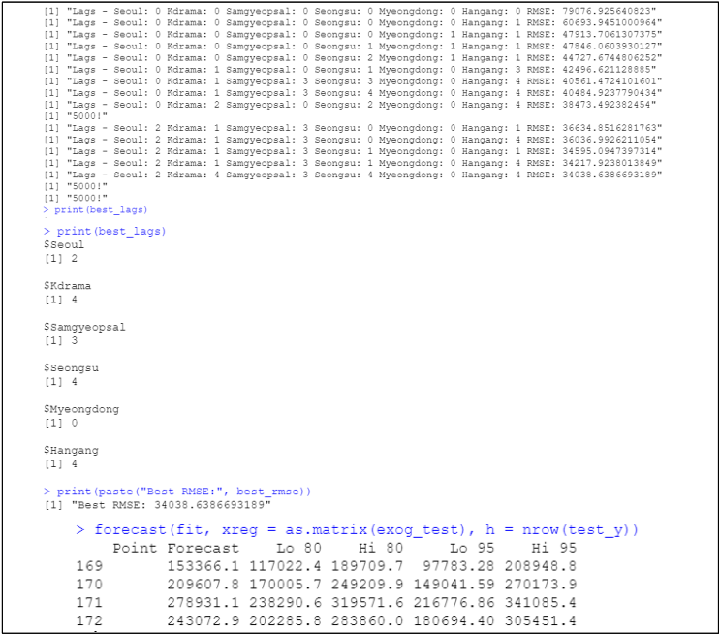
Time Series Data Analysis and Forecasting Final Project
Methodology and Result
SARIMAX model including multiple keywords
Methodology
: If a Japanese searched any keywords in Jan, 2024, it is more likely to come Korea after one to four months.
: Including lag from 0 to 4 and 5 number of keywords, the loop generated by data from January 2010 to December 2023, tests 5^6 models by RMSE criteria which is calculated by out-of-sample data, from January 2024 to April 2024. : Chicken Rib is removed as the data of earlier period is almost 0 and the number of data is different from that of DV.
2. Result
: The lags of variables are 2,4,3,4,0,4 for Seoul, K-Drama, Samgeopsal, Seongsu, Myeongdong, and Hangang.
: RMSE is lower than that of SARIMAX with one keyword.

Slide 24
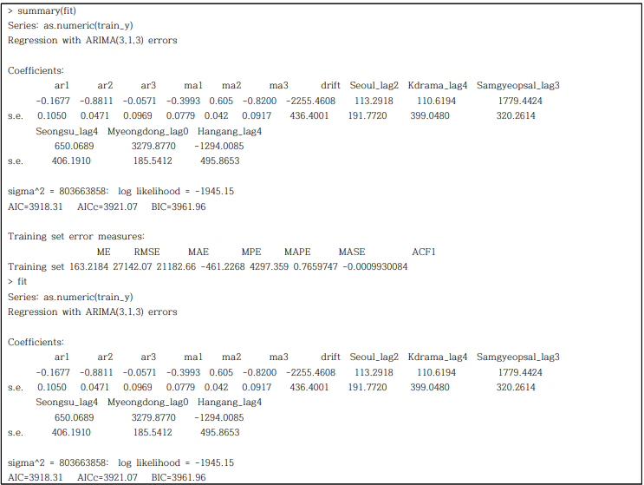
Time Series Data Analysis and Forecasting Final Project
Methodology and Result
SARIMAX model including multiple keywords
Full Model
: The impact of each variable can be interpreted by coefficients.
: The values of coefficients are on the left.
2. Result
: Searches for samgyeopsal before a trip significantly influence the number of tourists in the subsequent period
: Searches for Myeongdong during
the current month influence the number of tourists in that same month

Slide 25
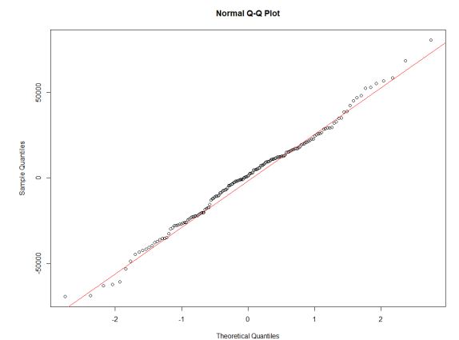
Time Series Data Analysis and Forecasting Final Project
Methodology and Result
Q-Q plot

Slide 26
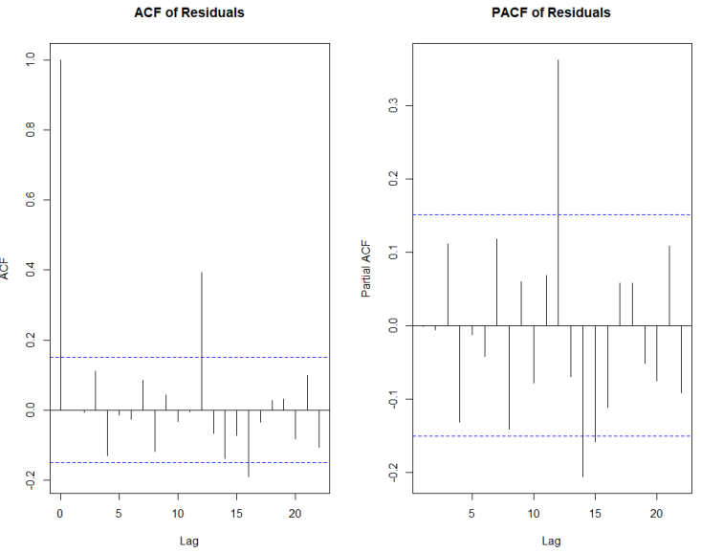
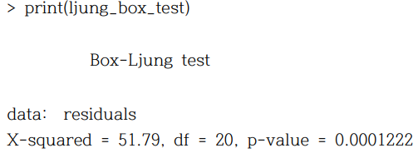
Time Series Data Analysis and Forecasting Final Project
Methodology and Result
Box-Ljung test and ACF and PACF of residuals
The residuals of the model includes autocorrelation

Slide 27
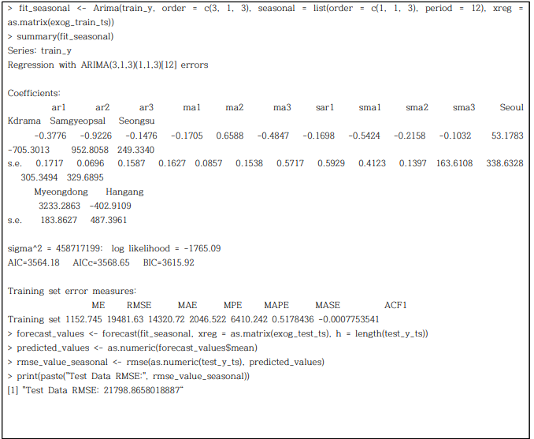
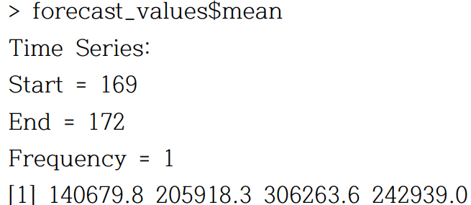
Time Series Data Analysis and Forecasting Final Project
Methodology and Result
Manually fitted SARIMAX model including multiple keywords
Result
: The new model has much more improved prediction RMSE results than the both prior full model and the each model using just one key-word data

Slide 28
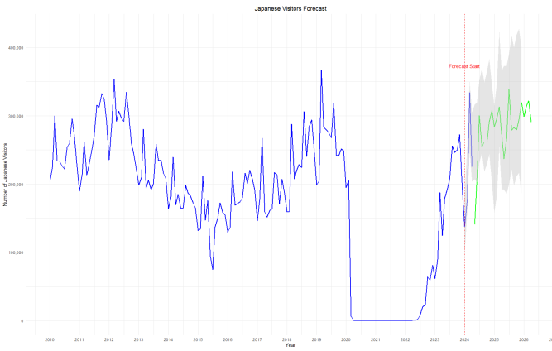
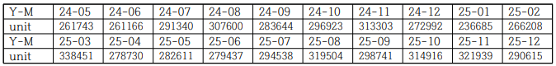
Time Series Data Analysis and Forecasting Final Project
Methodology and Result
Manually fitted SARIMAX model including multiple keywords
Result
: The prediction result of the Japanese visitors during May 2024 to Dec 2025 are shown above chart and the left graph is the forecasting plot by using the final model

Slide 29
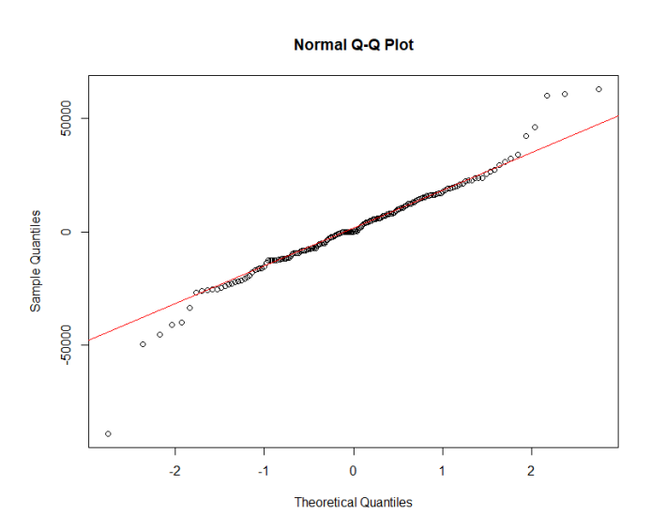
Time Series Data Analysis and Forecasting Final Project
Methodology and Result
Q-Q plot

Slide 30
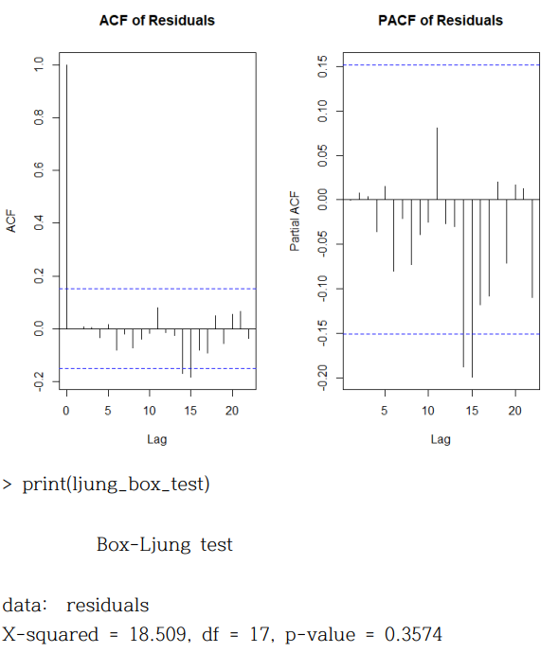
Time Series Data Analysis and Forecasting Final Project
Methodology and Result
Revised Full-model test results
Result
: No autocorrelation is found in the model

Slide 31
Time Series Data Analysis and Forecasting Final Project
Expected Original Contribution
Significance
The number of Japanese tourists visiting Korea declined in the late 2010s and around the time of COVID-19, but is recovering after COVID-19 and has reached close to its previous peak.
Examining the forecasting models used to predict future demand for Japanese tourists visiting Korea to provide an opportunity for practitioners to supplement and develop the results of this study
We checked what factors influence Japanese tourists through Google Trends and considered various related policies.
The Most interesting part is the search volume of Korean dramas in Japan has a weaker relationship with Japanese people's visits to Korea than other factors

Slide 32

Time Series Data Analysis and Forecasting Final Project
Expected Original Contribution
What we thoughts on Tourism Policy by Time-Series
Korean wave elements such as K-drama didn’t have an effect on the increase in the number of Japanese tourists, making it difficult to reflect them in policy.

Slide 33
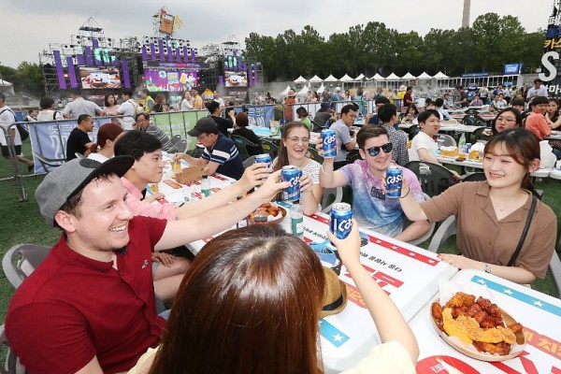
Time Series Data Analysis and Forecasting Final Project
Expected Original Contribution
What we thoughts on Tourism Policy by Time-Series
Like the German Beer Festival, develop a cultural festival where foreigners can sample and experience the taste of one Korean food element, such as Korean style Pork belly and pancakes, for free event.

Slide 34
Time Series Data Analysis and Forecasting Final Project
Expected Original Contribution
Detail Policy Recommendations - Place
For Myeongdong, it was found that tourists tend to search for this specific area in advance of their visit, with a very significant impact observed within a one-month lag. In contrast, the effect for samgyeopsal was observed with a three-month lag.
Based on these results, for Myeongdong, it is clear that tourists do not plan their visits far in advance. Therefore, continuously promoting this area through events could be effective. For instance, marketing campaigns targeting Myeongdong should not be executed three to four months in advance, as such long lead times do not significantly influence travel decisions. Given the short lag, we suggest small-scale, continuous promotions.

Slide 35
Time Series Data Analysis and Forecasting Final Project
Expected Original Contribution
Detail Policy Recommendations - Food
For samgyeopsal, the analysis shows a significant impact with a relatively long lag. Typically, tourists make specific plans for their trips closer to the departure date, but they consider what to eat much earlier. This is further supported by the high correlation between samgyeopsal and k-idol searches. The longer lag can be easily understood when considering that planning to attend an idol concert or fan meeting might be reflected in the search data well in advance of the trip for about 3 months.
Therefore, we propose conducting promotional events centered around well-established franchise restaurants or reputable individual eateries that properly represent Korean samgyeopsal culture, focusing on tourist hotspots in Seoul popular among Japanese visitors. Additionally, such promotions can be integrated into group tour packages, as suggested by previous research.

Slide 36
Time Series Data Analysis and Forecasting Final Project
Expected Original Contribution
Detail Policy Recommendations - Influencer
Next, idols may be able to supplement the low season 'Summer' as well as make stronger at spring and fall. Through additional research on Idol groups that Japanese prefer, it is possible to make a waterbomb concert that is usually held in summer and implement strategies to induce them to visit Korea more easily by linking tour packages including these festivals. Through this approach, we will be able to find ways to increase the number of Japanese visitors to Korea in summer.
Meanwhile, the importance (search volume, etc.) between keywords not covered in the PPT will be covered in detail in the report.

Slide 37
Time Series Data Analysis and Forecasting Final Project
Reference List
References
1. Ministry of Culture, Sports, and Tourism, South Korea. "Number of Domestic Travel and
Increasing Rate." Accessed [JUNE 20, 2024].
2. 김보경. "한류 알려온 '케이콘' 12년 역사 처음으로 9월 독일서 개최." Naver News. June 21, 2024.
3. Wells, Pete. "The Top Dishes of 2023 in NYC." The New York Times. December 13, 2023,
https://www.nytimes.com/2023/12/13/dining/top-dishes-nyc-2023.html
4. Ministry of Culture, Sports, and Tourism, South Korea. "Annual Number of Travelers from Japan and Total." Accessed [June 20, 2024].
5. Japan National Tourism Organization (JNTO) and Ministry of Culture, Sports, and Tourism, South Korea. "Monthly Number of Korean Tourists Visiting Japan and Japanese Tourists Visiting Korea." Accessed June 23, 2024.
6. Molemeng. (2023). The Factors Influencing the Number of Visits and Behavioral Intentions
7. Deukhee Park, Sanghoon Kang, and Gyehee Lee. "Demand Forecasting of Japanese Tourists to Korea for Sustainable Tourism Growth: An Application of Time-Series Econometric Models." Journal of Tourism Studies 34, no. 3 (2020): 47-60.
8. Soeon Park, Gunhee Lee, and Inhye Lee. "Analysis of Factors of Visiting Tourists to Korea using Economic Variables and Media Data: A Case Study of Japan and Chinese Tourist." International Journal of Tourism and Hospitality Research 29, no. 7 (2015): 57-72

Slide 38
Time Series Data Analysis and Forecasting Final Project
The End
2024. 06. 12. 수

